Slide 1
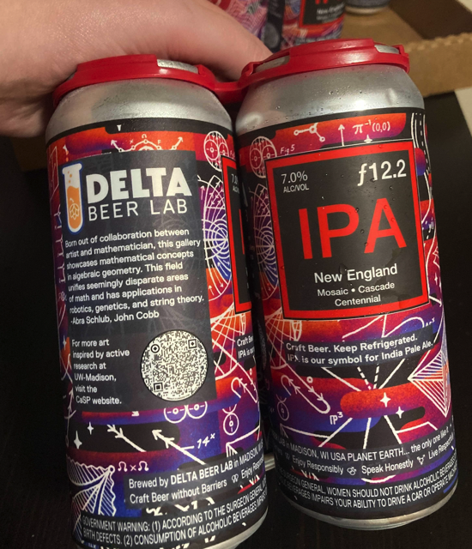
Label Design
John Cobb, Abra René
Notes:
Hi! My name is John Cobb. I’m a PhD student in the mathematics department at the University of Wisconsin-Madison studying a field called algebraic geometry and the talented artist behind the beautiful design on the label of Delta Beer Lab’s new can of New England IPA is my friend Abra René.

Slide 2
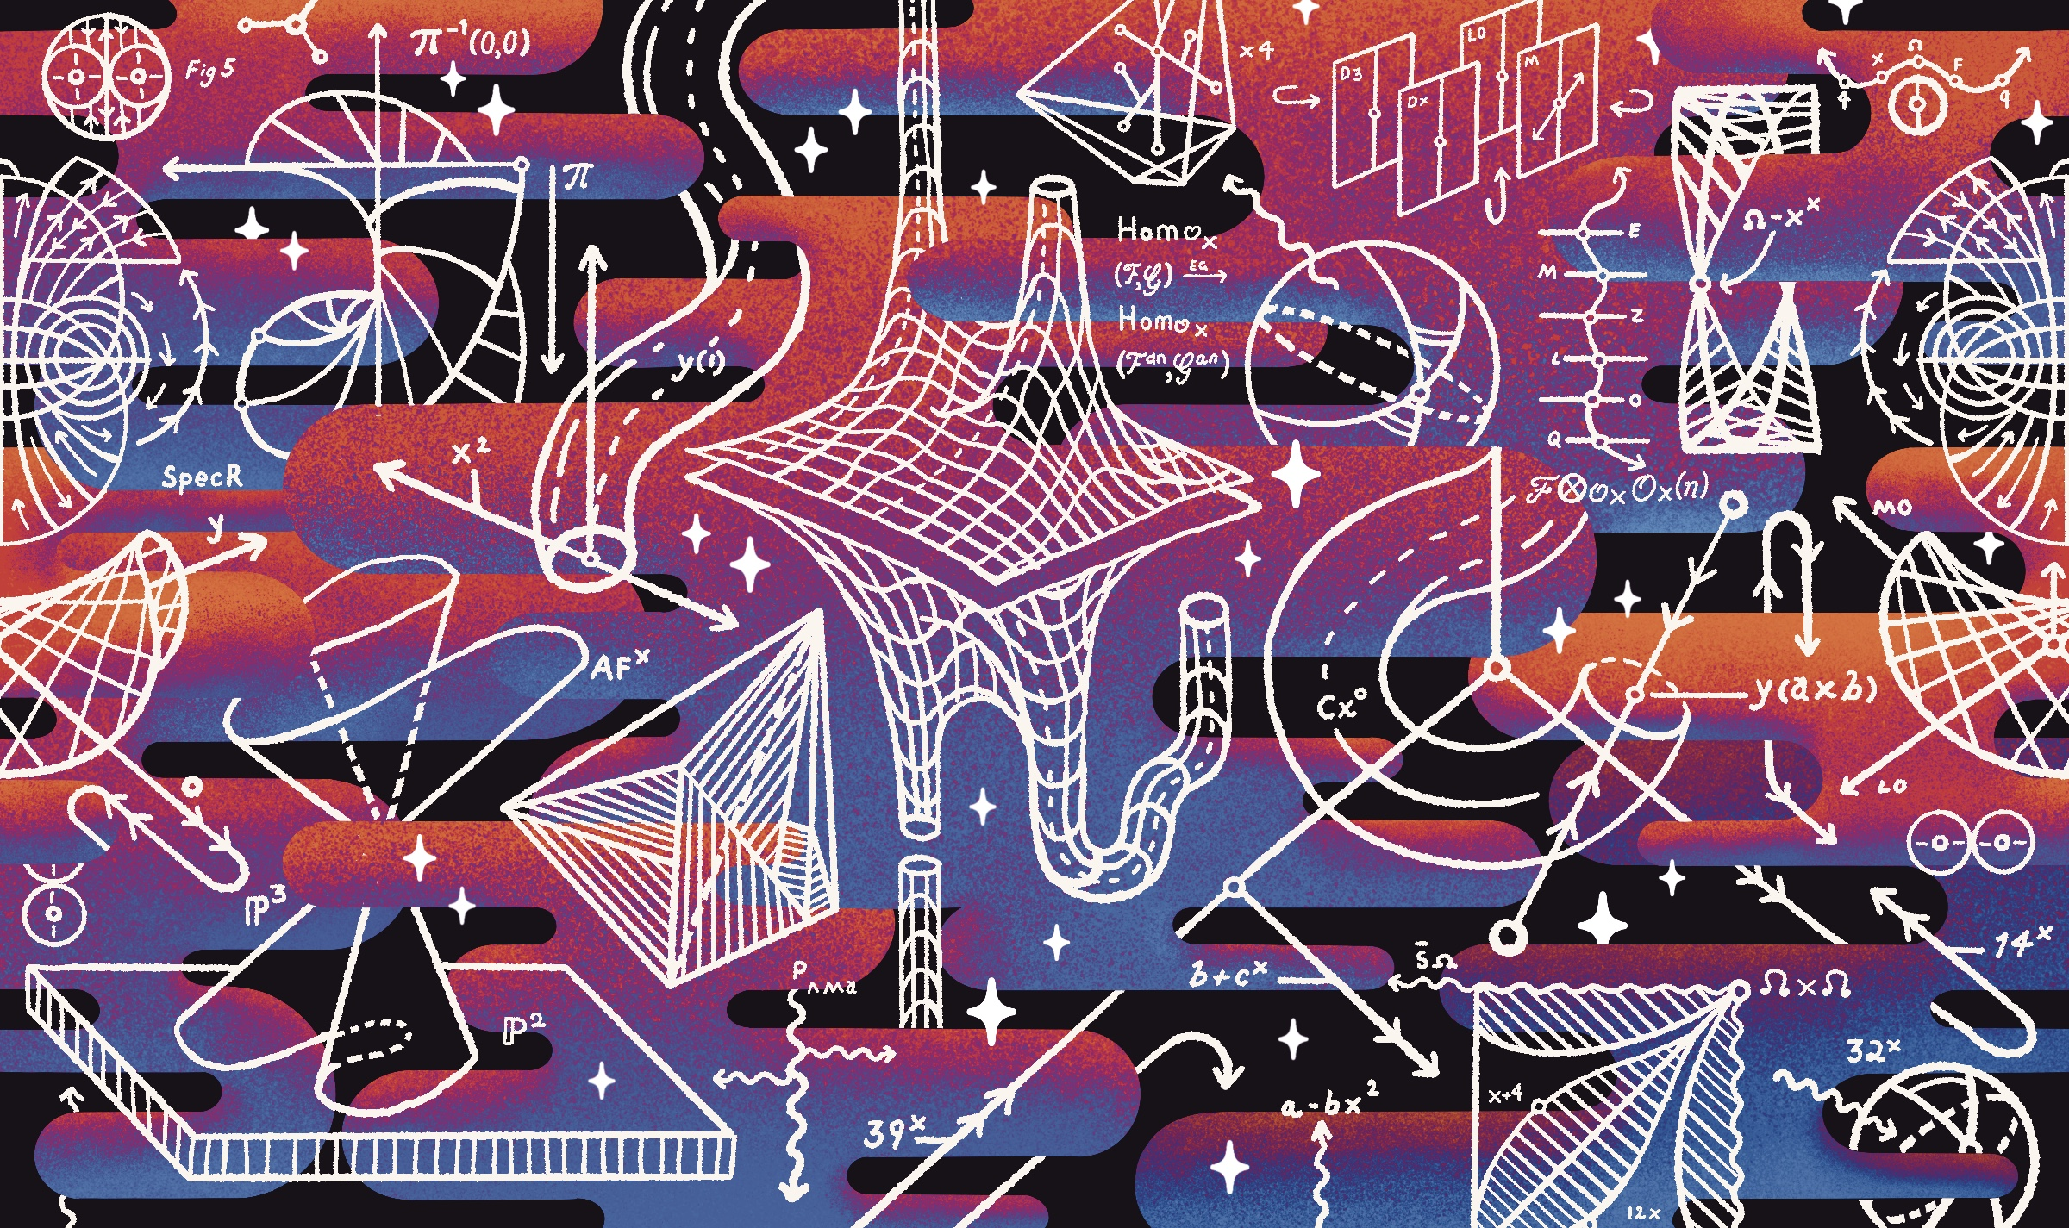
Notes:
First off, here is the design. So beautiful, love it. I’m so so tickled that its on a beer can. I’m outside of Madison currently, so I haven’t had a chance to try the new beer but I’ve been telling everyone I know about it – very proud of it. The can will have a place of honor, a shrine if you will, in my apartment. I’ll be sending many to my family and friends. I’m not sure if you’ve noticed, but there is a real shortage of beers that are mathematically themed, so as a self-appointed ambassador of all of mathematics I’d like to say that this is a real win. Not many people out there that like a nice can of math.
I’m not going to take up too much of your time, but as the trivia group gets set up I’m just gonna talk a little bit about how the label came to be and give more details about the figures all over it.
In case my powerpoint slide designs did not clue you in, I’d like to again to point you towards the artist with big red arrows.

Slide 3
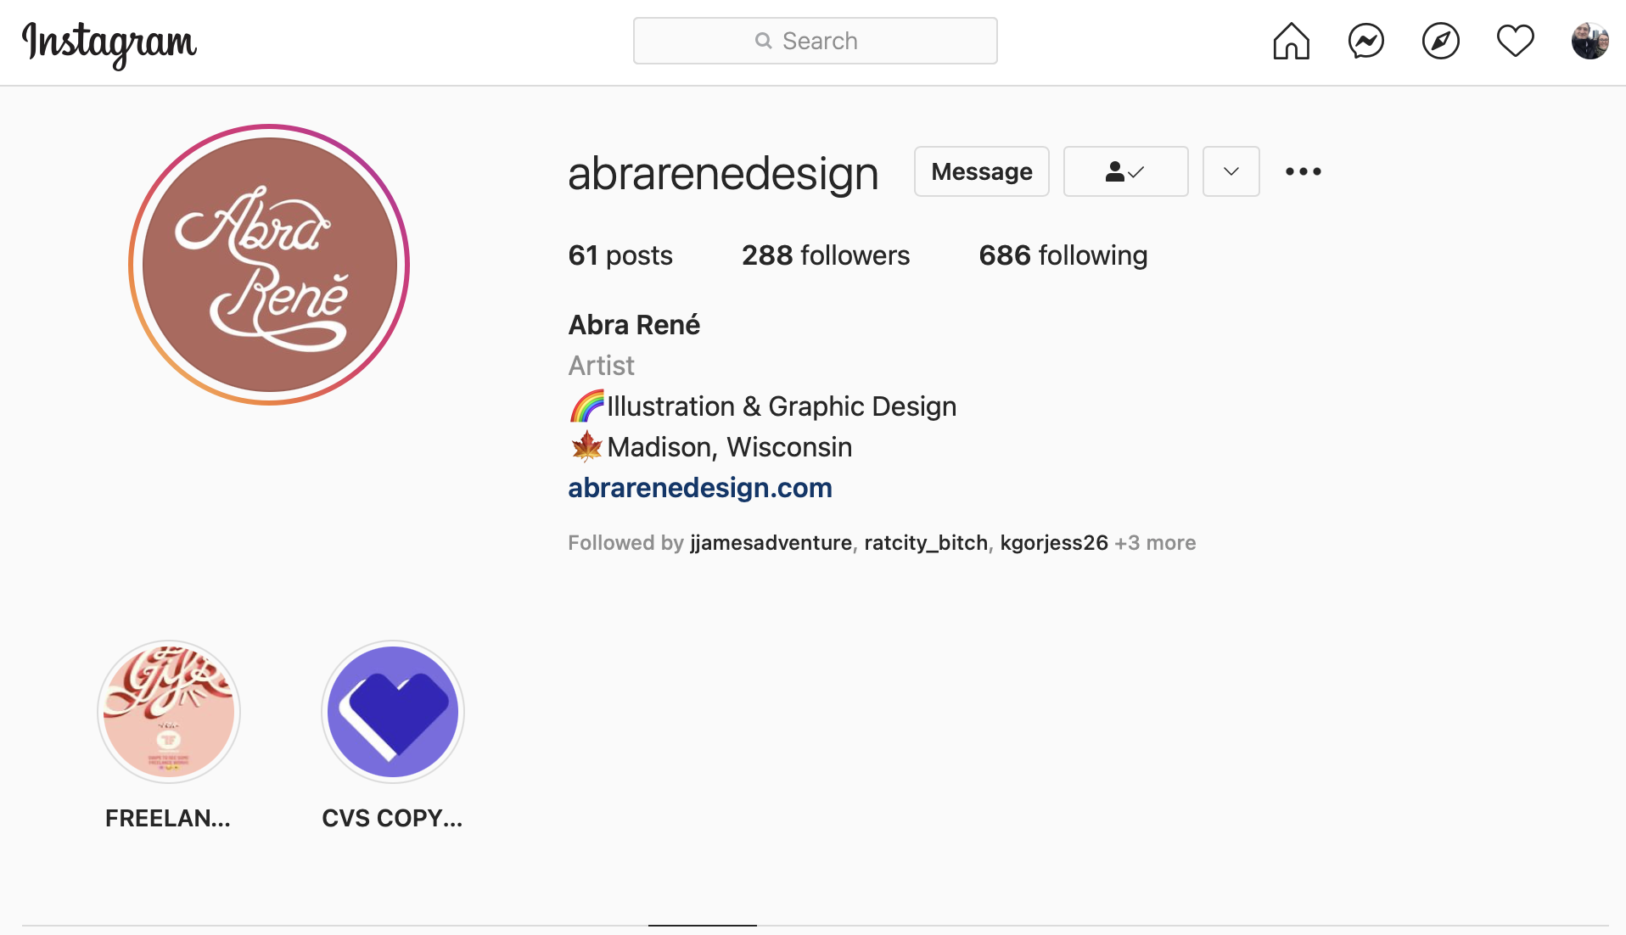
Notes:
That’s Abra and here is her Instagram info. I met her at a board game night with some friends during the pre-covid era and she is good friends with my wife Jordan. After I learned of this beer label competition, I had the vague idea of taking some of the beautiful and compelling figures and illustrations in some of the resources I use in math and putting them together in an abstract way. So I compiled a big list of figures from some of my favorite papers and textbooks, some other mathematical art I’ve seen, knew she would rock it and hoped she’d help me. By help I mean, entirely design and produce. I’ll let her say more about that process later.

Slide 4
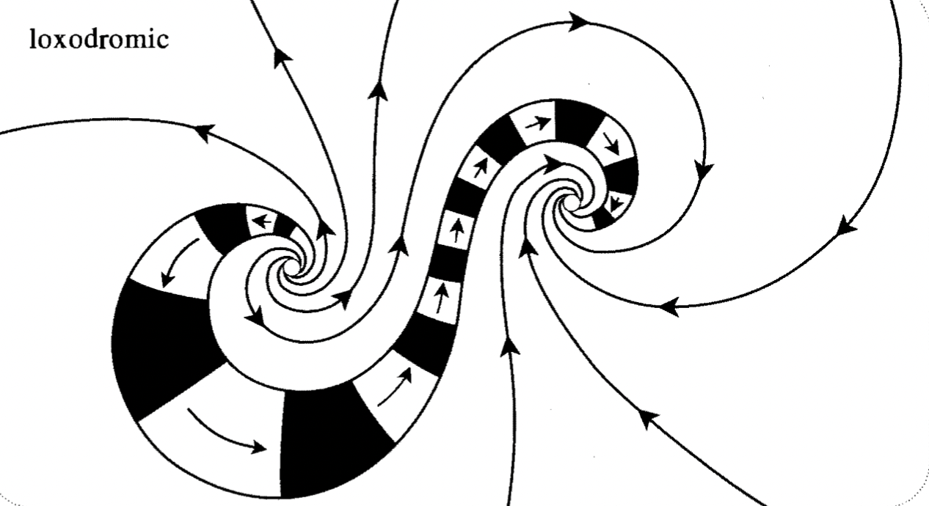
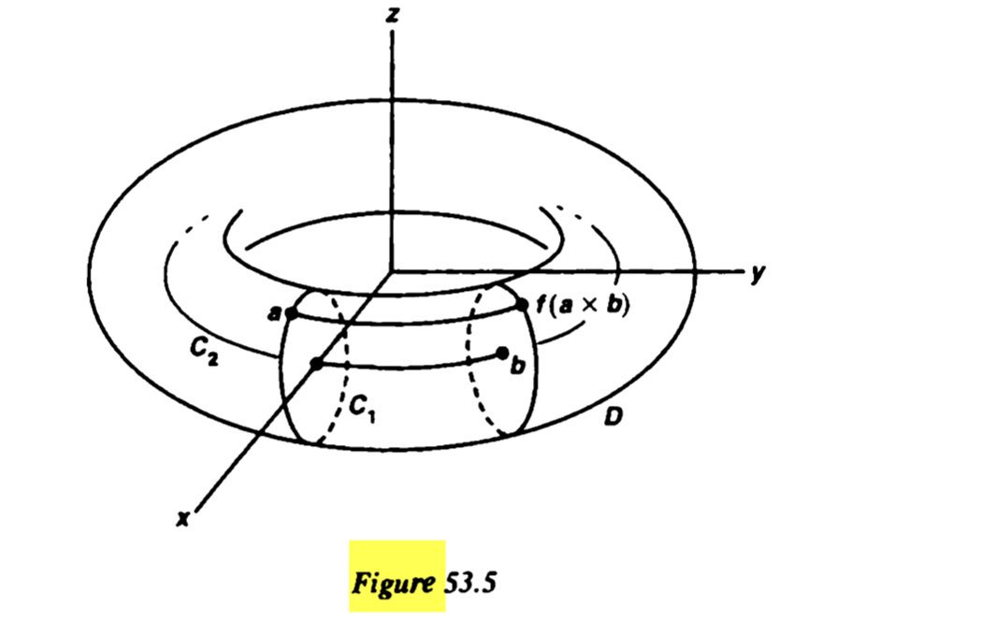
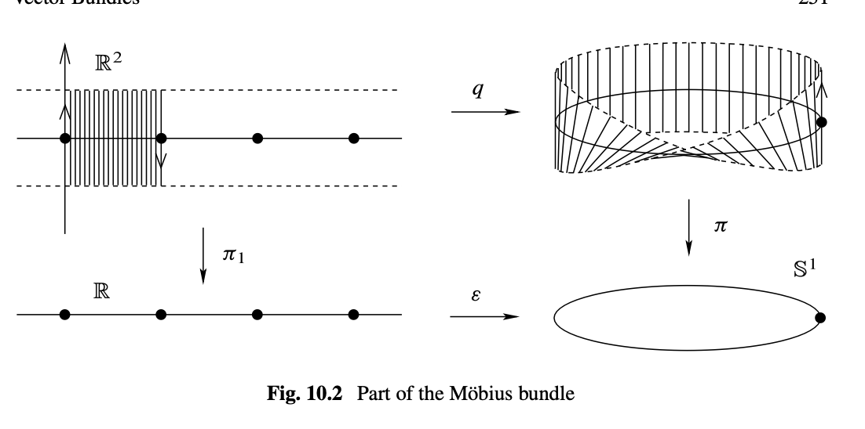
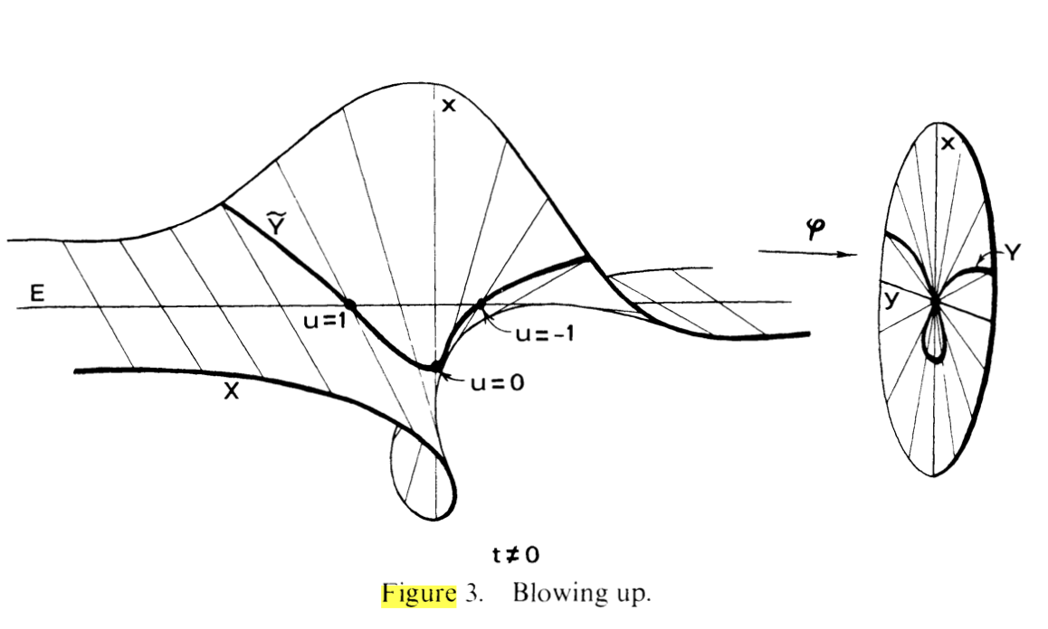
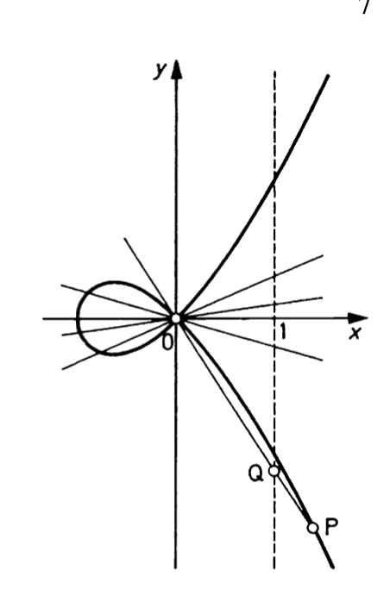
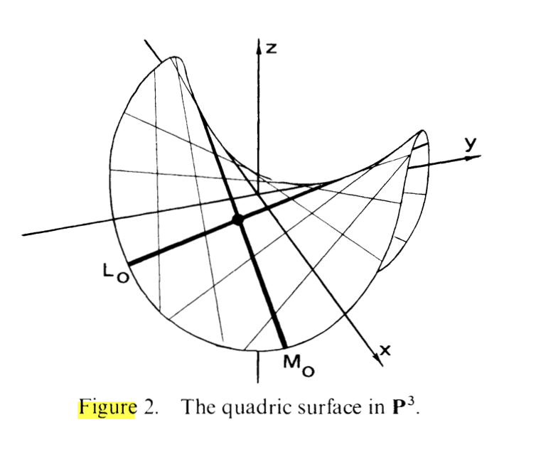
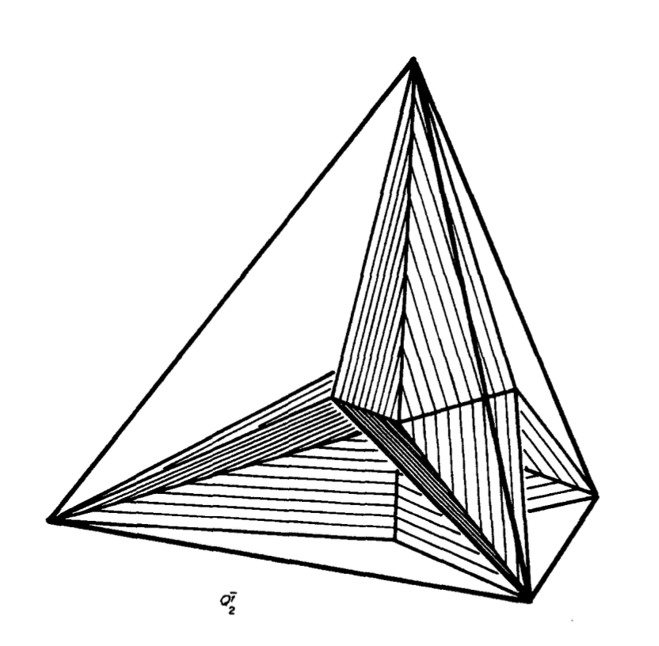
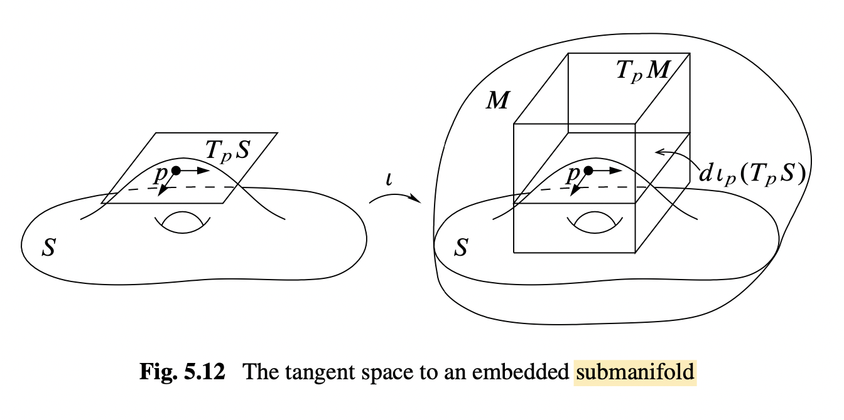
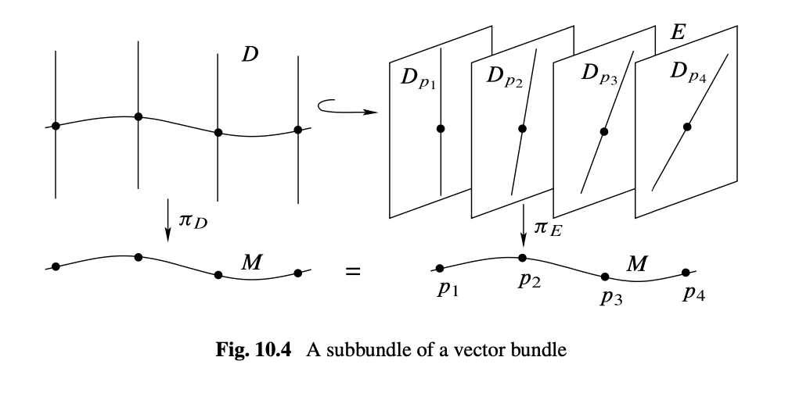
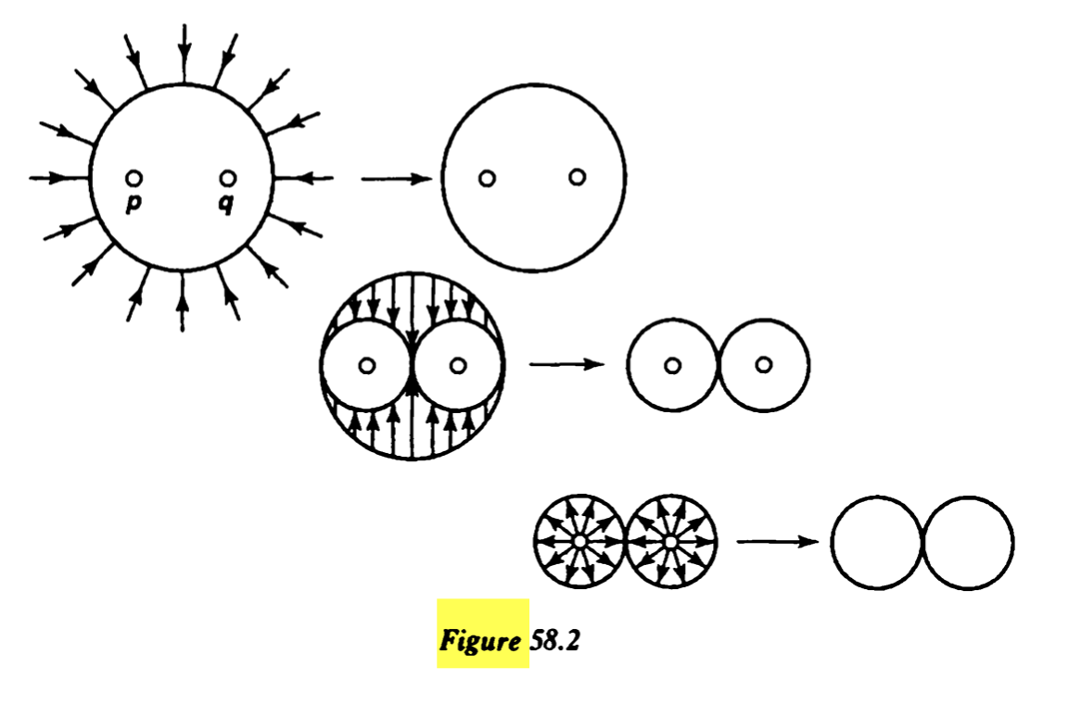
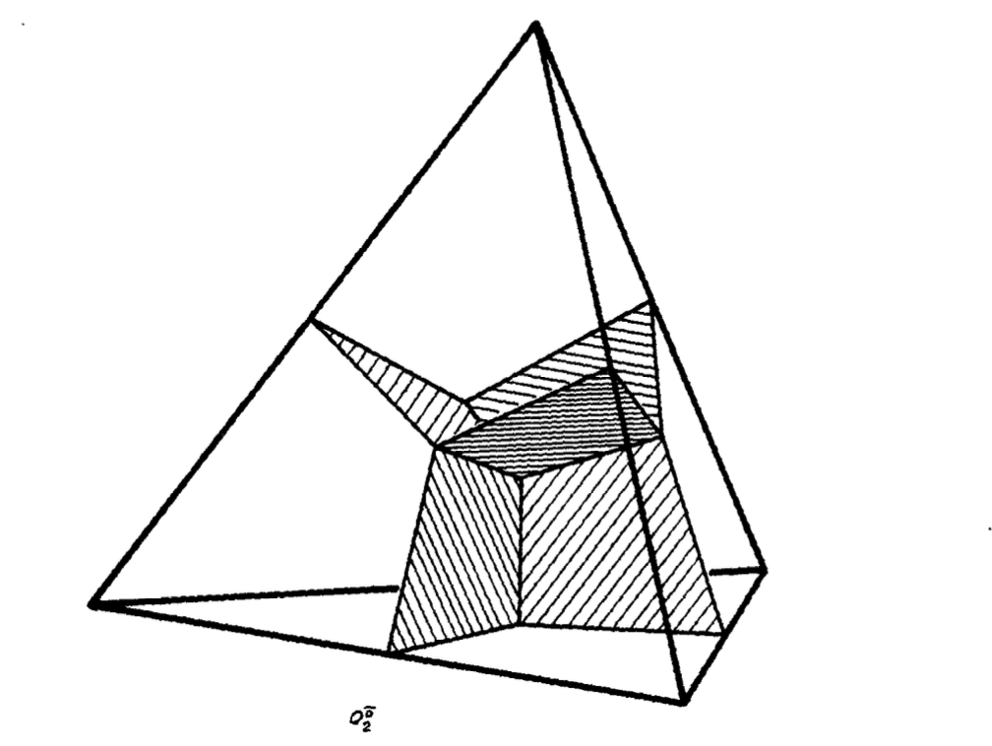
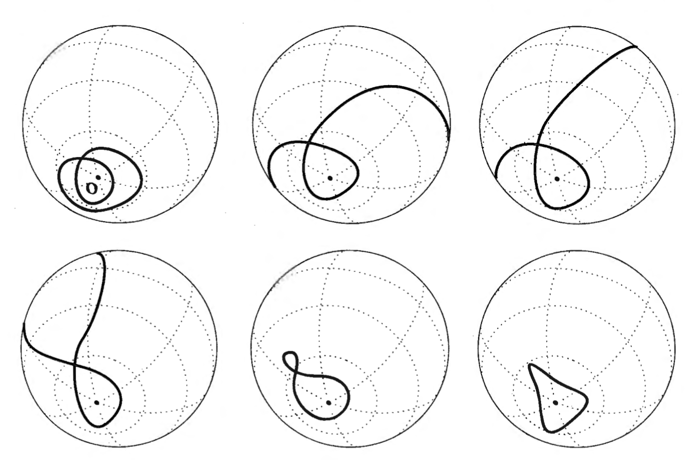
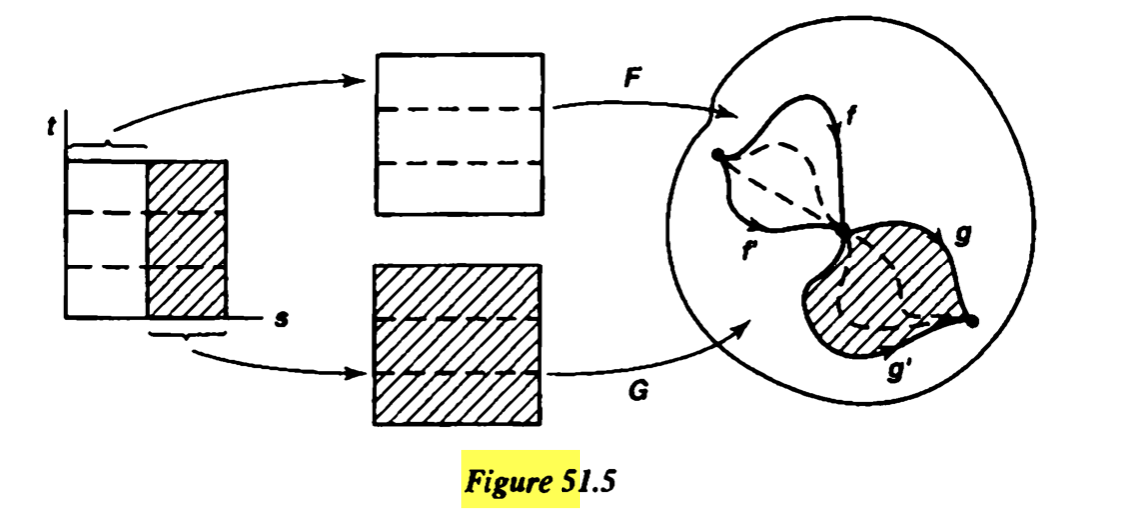
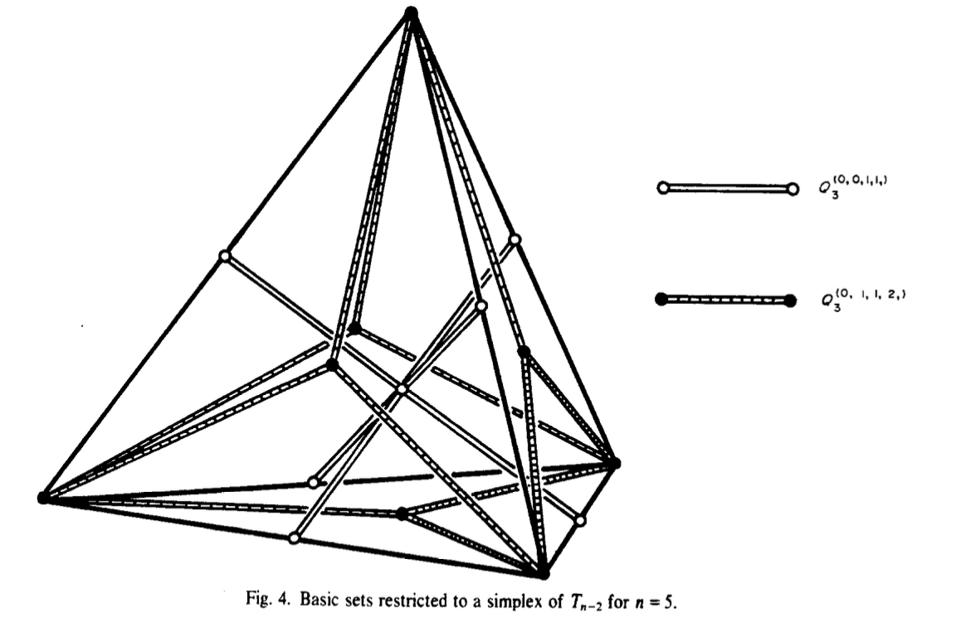
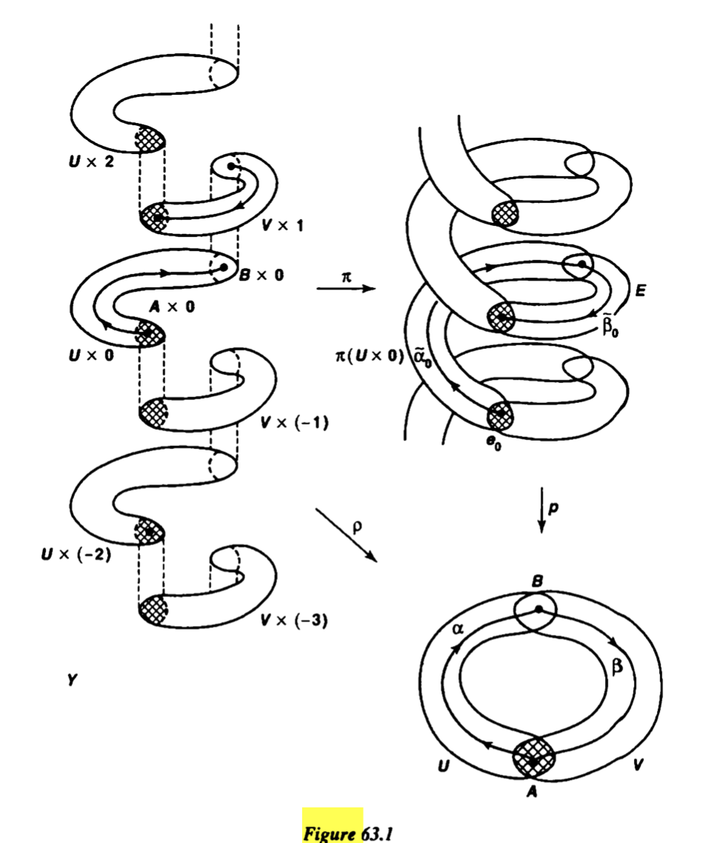
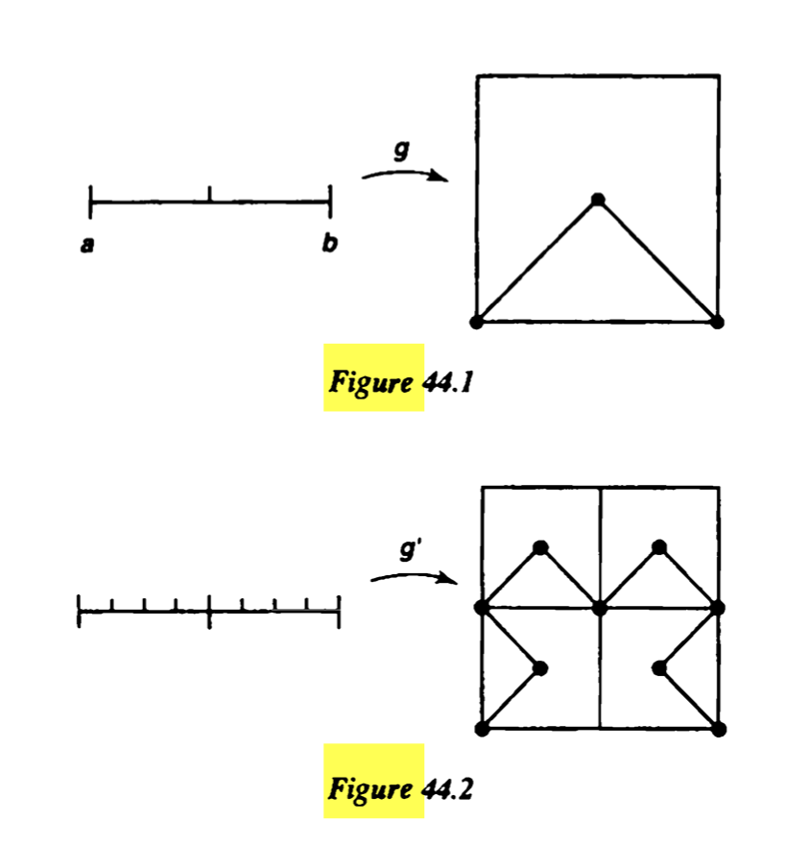
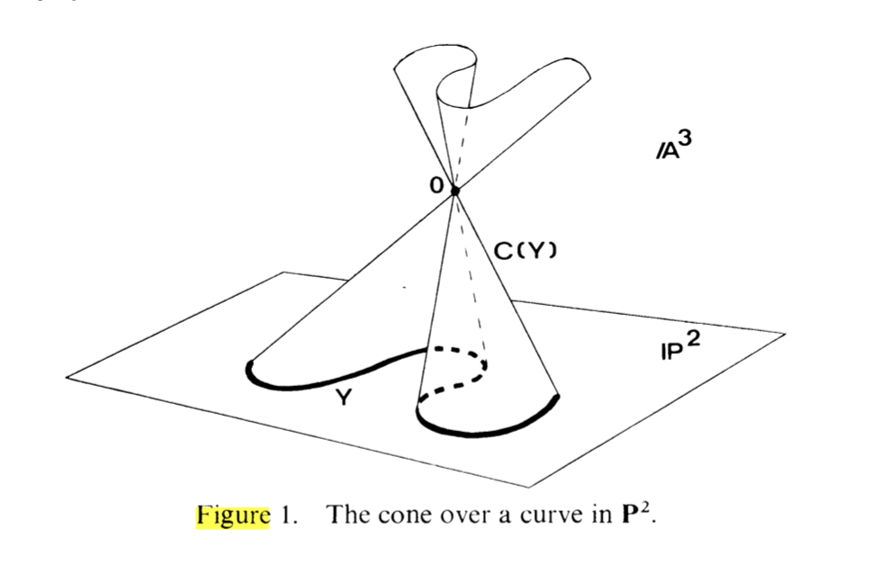
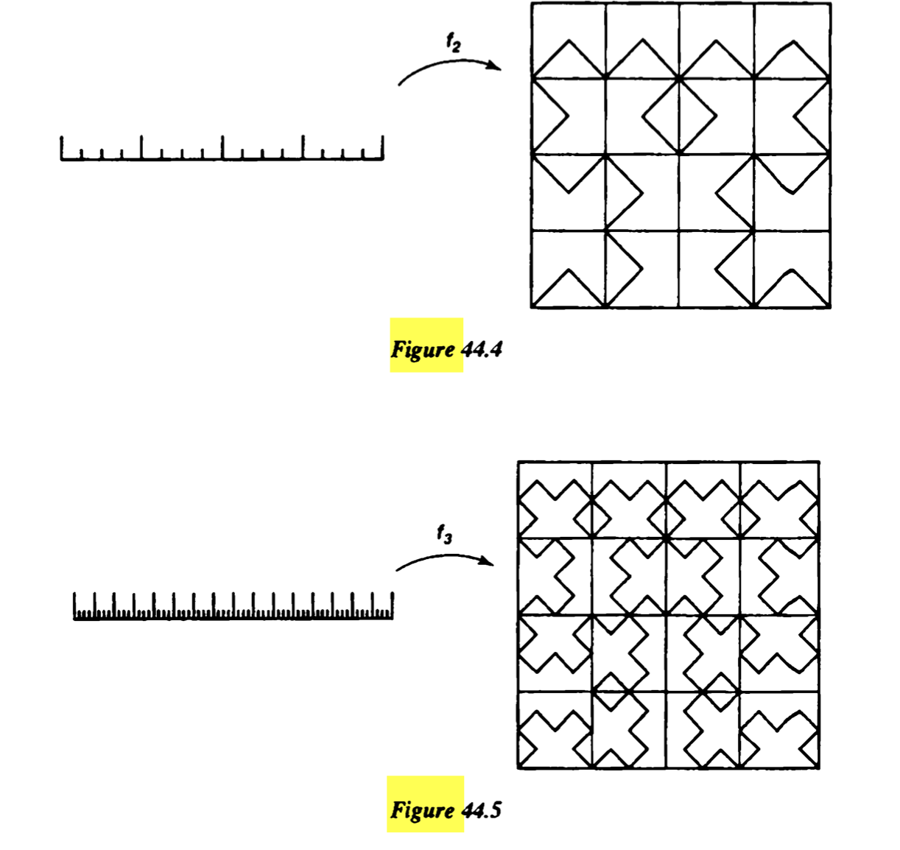
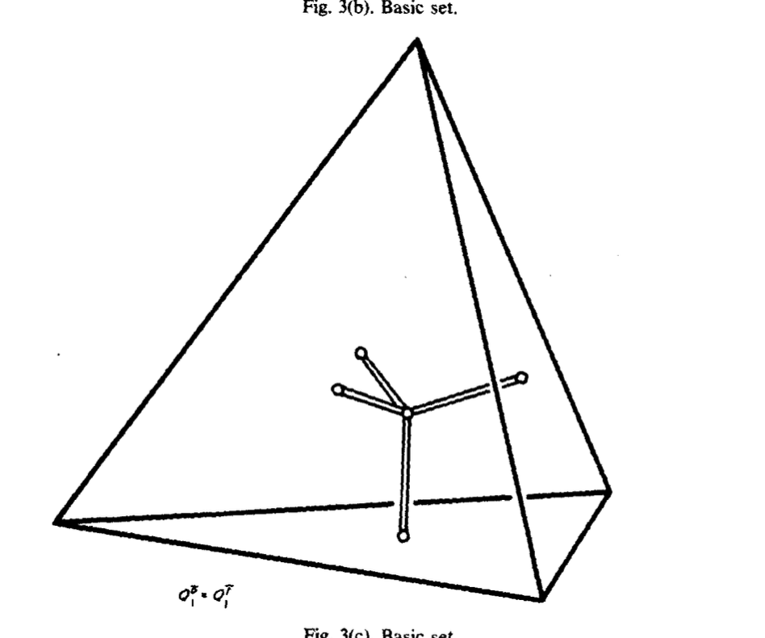
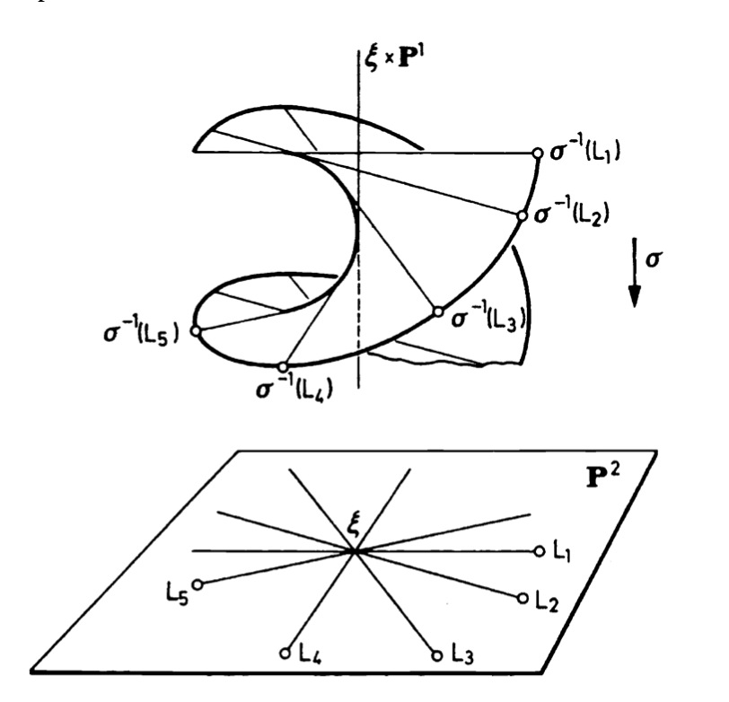
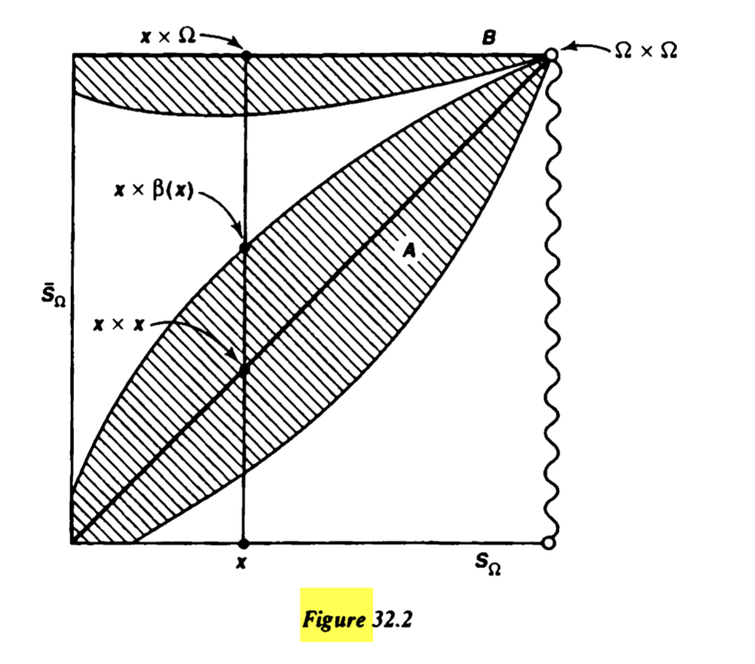
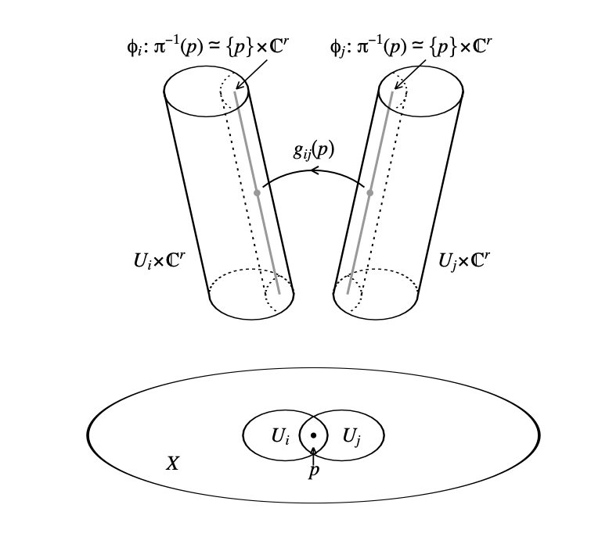
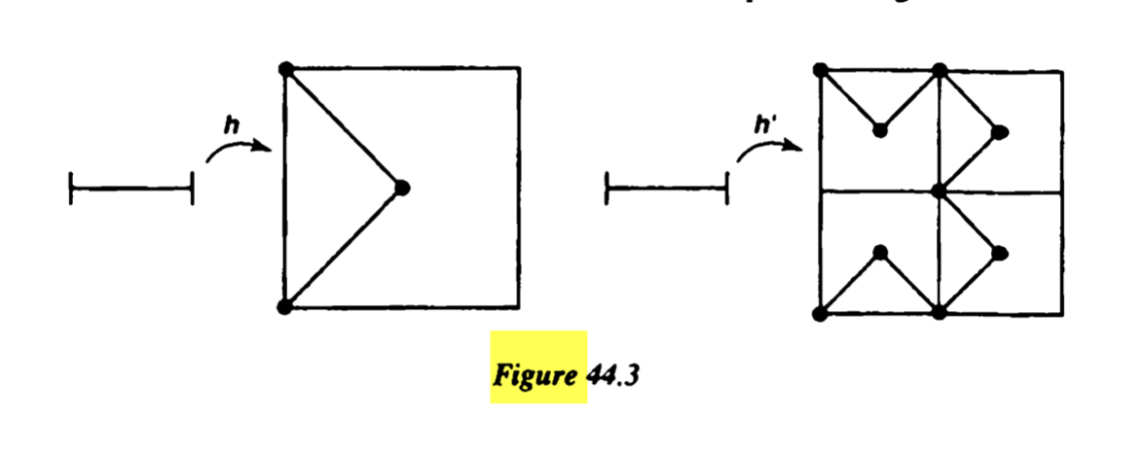
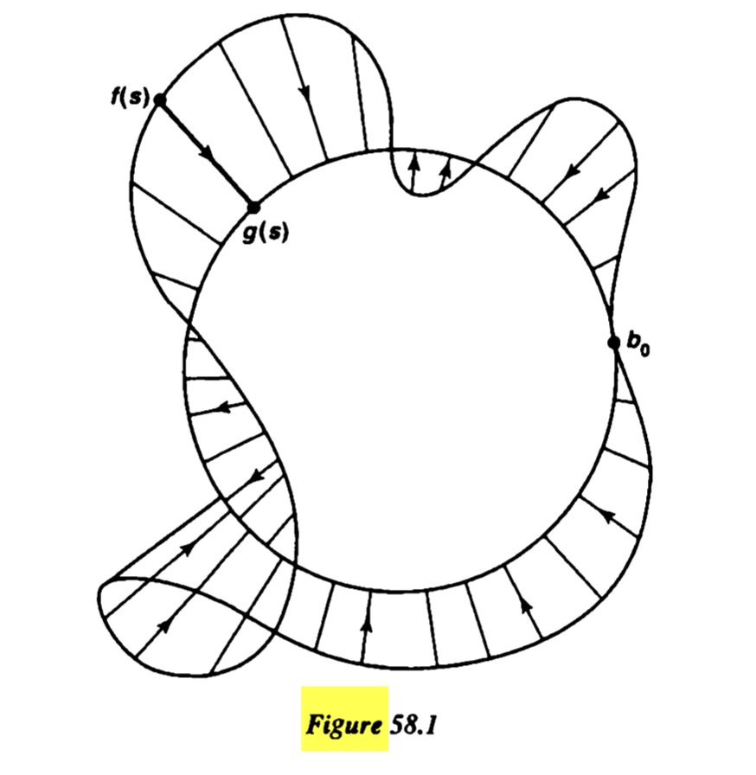
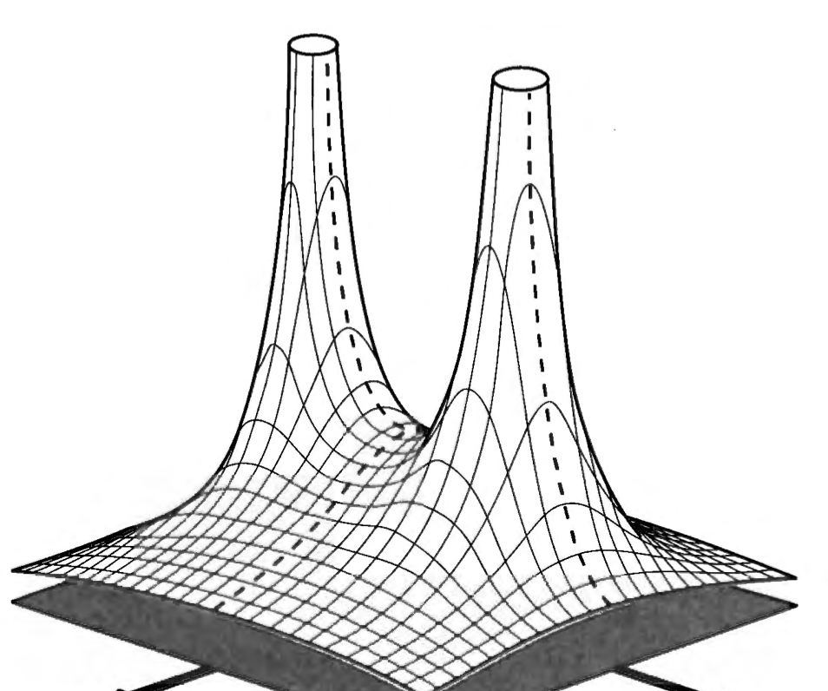
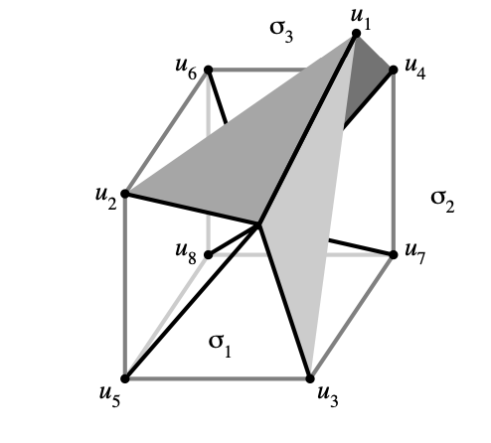
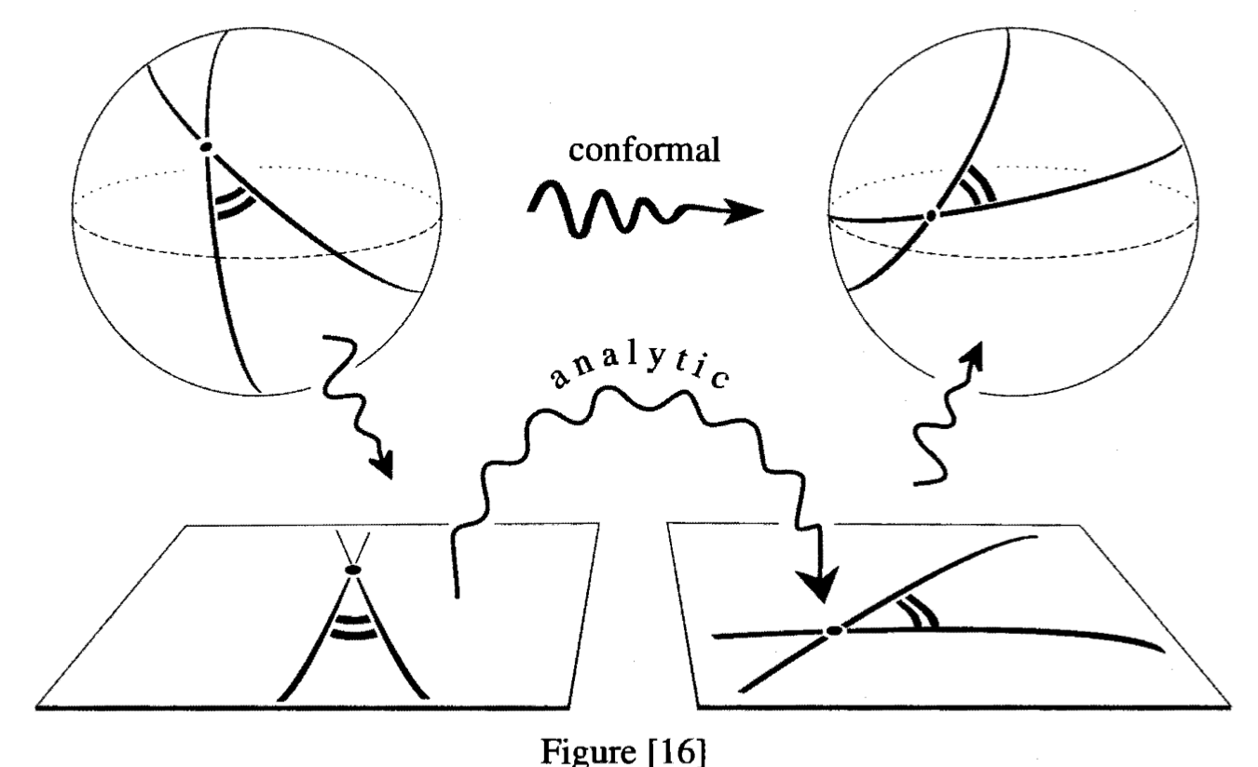
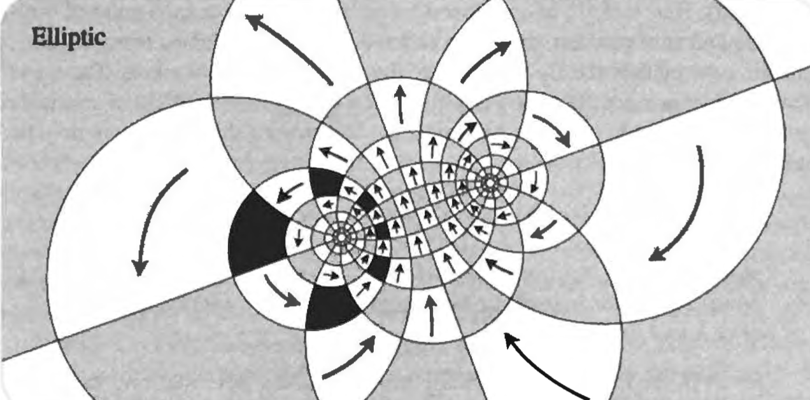
“The mathematician’s patterns, like the painter’s or the poet’s must be beautiful; the ideas like the colours or the words, must fit together in a harmonious way. Beauty is the first test: there is no permanent place in the world for ugly mathematics.” -G.H. Hardy
Notes:
And when I mean a lot of figures, I mean quite a bit.
The major goal was to sort of showcase the role of creativity and beauty in mathematics, and to challenge (what I think of as) a common misrepresentation of mathematics – that it’s a very ”left-brained” activity, and filled with lifeless calculation. This was a harmful conception that I held myself coming out of high school – I felt that math was a collection of cherry picked tools you use to solve cherry picked problems, and this idea of mine was really challenged when I began taking more higher level math throughout the course of my chemistry major.
So I found these figures that I felt are very enticing. Its true that math requires a lot of precision, but looking at some of these intricate diagrams and “big picture” ideas has a way of drawing you in and asking “That looks wild, what the heck are they talking about?” because that feeling was and is a big part of my personal attraction to the subject.
If you unwrap the content of many of most esteemed, important, and useful mathematical ideas in history, they started with some really crazy and inventive insight that challenges you look at everyday things in a new way. I mean look at some of this wacky illustrations. This is like thousands of years of cumulative human effort on the screen, and more than this, they secretly underly tons of the technologies we take for granted. And its hidden away in dusty old math tomes!

Slide 5
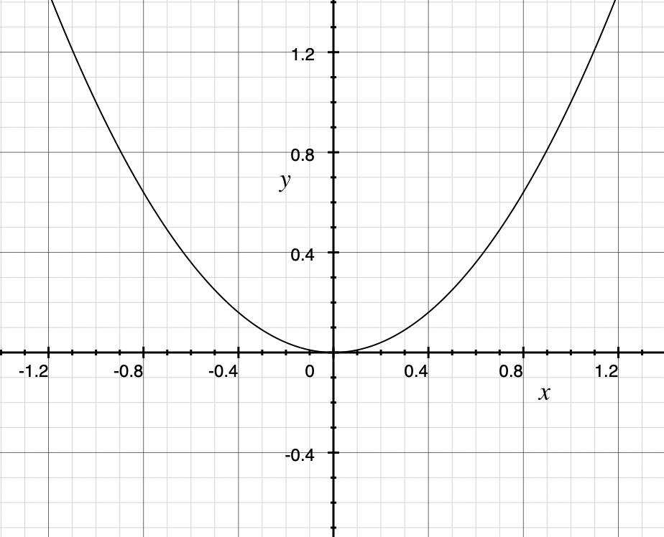
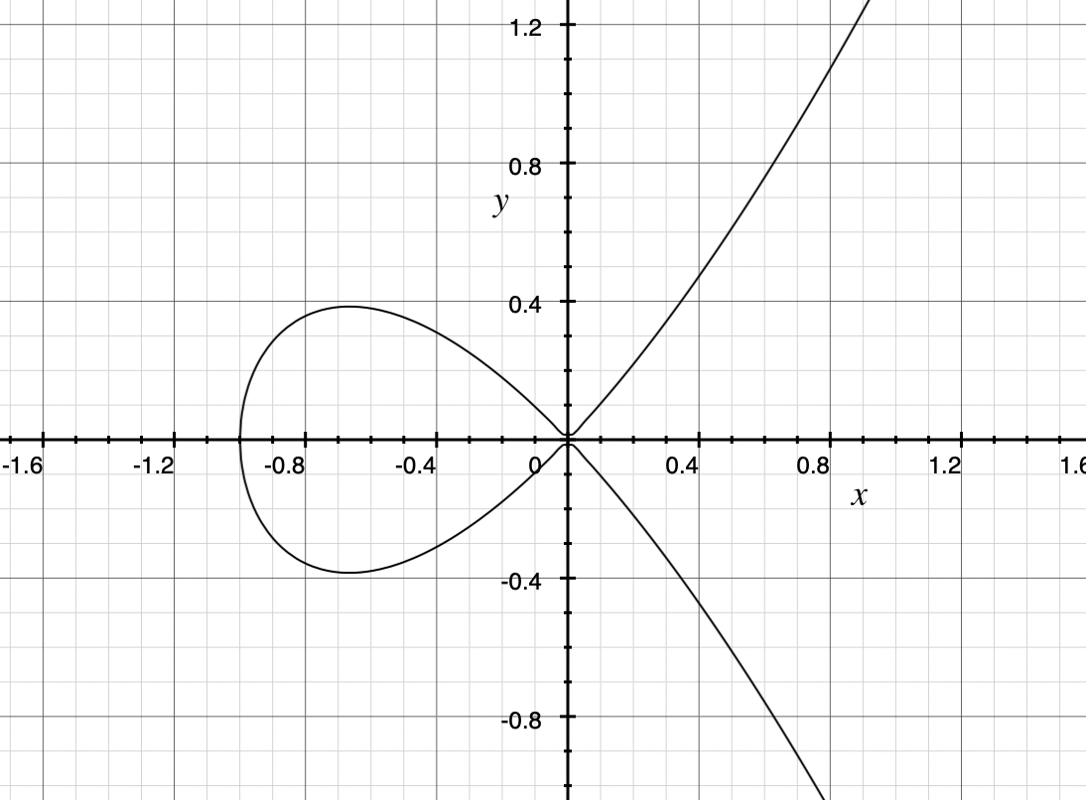
What is algebraic geometry?
Its place in mathematics: Incredibly central and active
Starting point: algebraic geometry seeks to turn questions about polynomials into questions about shapes in space (and vice versa)
$${y=x}^{2}$$
$$y^{2}=x^{2}\left(x+1\right)$$
Why? What are the applications?
Notes:
Now that I’ve done my obligatory waxing poetic about math in general, I’d like to just briefly describe some of the figures on the label. But before that, since the label features things primarily in my own field that I’m studying, I’d like to give the flavor of algebraic geometry. Feel free to stop me at any point if you have a question, or email me later I’ll give that on the last slide.
First thing to know about algebraic geometry is that it is an incredibly active field, and is not at all some collection of static theorems and facts. It has grown into a language of sorts, and connects many different fields together under a common framework.
Classic algebraic geometry can be somewhat summed up pretty easily: It seeks to turn questions about polynomials into questions about shapes in space and vice versa. So algebraic geometry is exactly what the name suggests: it is an algebraic way of thinking about geometry. Or a geometric way of thinking about algebra. For example, we probably all learned at some point that the polynomial x^2 is associated with this bendy line over here called a parabola. It wasn’t always associated with this shape, but we all do it nowadays because it is useful to think of it that way. If we made our equation more complicated, we get other types of shapes. How might we go from one side to the other? The techniques of algebraic geometry gives us these answers. Of course we could go up in dimensions, talk about complex numbers, etcetera..
If this was the end of the story for algebraic geometry, it would still be cool. But its been massively abstracted and generalized so that we can talk about the geometry and algebra of lots of different things, and this big push was what really made AG the thing to know.
So my personal draw to algebraic geometry is to better understand yet other math, but it is being used for lots of real world applications. Just in the classical setting, algebraic geometry has given us these complex ways of understanding solutions to systems of polynomial equations through geometric considerations (think: ”I can find zeros of quadratics by seeing where they intersect the x-axis”). So algebraic geometry is used to solve for the motions of robotic arms as the move through space, they help with the computations related to genetics research, and there is a huge application in big brained physics things like string theory that I am not at all prepared to discuss.

Slide 6
Less annoying
annoying
Notes:
So now I thought I’d just say some of the words associated with a handful of these figures. I don’t expect it to make much sense, but I still thought it might be fun anyways.
This is a figure from a book called Hartshorne, which is a sort of famously difficult algebraic geometry textbook filled with exercises that are still unsolved to this day. It is showing how this space called projective space can be related in a more familiar setting called affine space.
Here is a picture of something called a “blow up”. (also from Hartshorne) You can “blow up” curves that you don’t like until they become less annoying. This curve on the right intersects itself, which we don’t like (this is called a singularity). But after blowing it up, it does not intersect. Fun fact: I have heard of occasions of algebraic geometers being stopped in airports for talking on the phone about blowing things up.
Here is a photo from a popular topology textbook called Hatcher. Topology studies spaces without a sense of distance, so we are free to sort of deform the picture as we will. This is a diagram showing how we can deform spaces to one another.
These are diagrams I found in a paper about something called intersection homology. These are examples of something called a topological psuedomanifold, and is demonstrating something called its stratification.
This is a diagram that is used to describe how something called vector bundles are glued together.
Another one from Hartshorne. This pringle chip looking thing is a representation of the product of two projective spaces through something called the Segre embedding.

Slide 7
Thanks!
email: jcobb2@math.wisc.edu
Notes:
Okay! That’s all I’ve got. If you have any questions about the math, go for it. Otherwise, I’mma hand it over to Abra to tell you about making this nonsense look appealing.
Thanks a ton for listening.

